Slide 1

Cloud base ETL DevOps process of Cognizant

Slide 2


Cloud base ETL DevOps Process Community
CEDC Introduction
在CEDC，增长软技能和硬技能，用我们团队自己研发的方案探索一切可能。在这里，你将收获利用业余时间快速成长技能的机会。
在这里，你将收获一套完整的新团队敏捷体系。
在这里，你将成为敏捷团队的主人，具备未来管理思维。
在这里，你将快速融入大连团队并在紧急时刻找到更好的资源帮助你成长和解决工作中的问题。
在这里，你将看到自己更大的潜能，并感受收获知识和技能后的喜悦。
Notes:
No any inputs

Slide 3

Contents / Agenda
Project Background
Project Mission
Project Goal
Project Milestone
Project Status
Project Details
Project Value
Project Challenge
Project Member

Slide 4

Project Summary
Notes:
And as we drive into 2020, I want to emphasize both my expectations from you – and the support that you can expect to receive as we succeed together

Slide 5
Project Summary
This project is aiming to build a whole cloud based DevOps ETL process. Include below Parts:
Cloud Infrastructure
Airflow framework
Jenkins Devops Pipeline
Glue ETL Common Solution
Multi-account architecture

Slide 6
Project Mission
Notes:
And as we drive into 2020, I want to emphasize both my expectations from you – and the support that you can expect to receive as we succeed together

Slide 7




Project Mission
项目建立初心：
在面临ChatGPT 4.0的发展, IT行业竞争激烈 ,且学习成本较高的环境下，提供给团队一个长期可持续学习的平台。该平台基于个人职业发展需求，站在数据领域前沿技术的全面视角， 通过实战的方式提升团队整体的软硬技能，发现人才挖掘潜力，培养敏捷思维，形成自驱型组织。模拟解决真实项目难题，在提高个人能力同时公司创造更大价值。
项目愿景：
敏捷模式
云上技能
敏捷思想
技能拓展
团队建设
AWS
AWS Glue
Airflow ETL Framework
Jenkins on AWS
拥抱变化与问题
共同思考，积极解决
集思广益，制定规则
报表与产品可视化能力,
模拟解决真实项目难题
有凝聚力的团队
灵活应对各种场景
人是一切之本，培养学习思维和能力更重要。
基础模式：承诺， 专注，尊重，开放，勇气

Slide 8

Project Goal
Notes:
And as we drive into 2020, I want to emphasize both my expectations from you – and the support that you can expect to receive as we succeed together

Slide 9
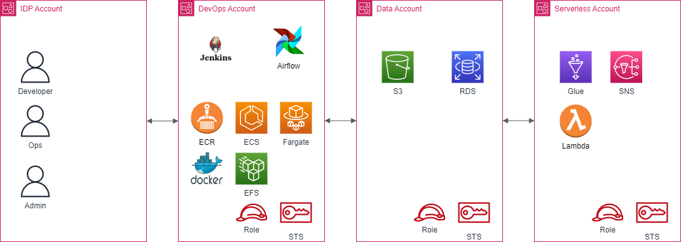
Project Goal
Account distribution
DevOps Account: this is a DevOps account mainly include Jenkins and Airflow
Data Account: this is a data lake account mainly include S3
Serverless Account: this is a ETL account mainly include Glue, Lambda etc
IDP Account: this is a Identity account which can assume A/B/C accounts by User role or Admin Role

Slide 10
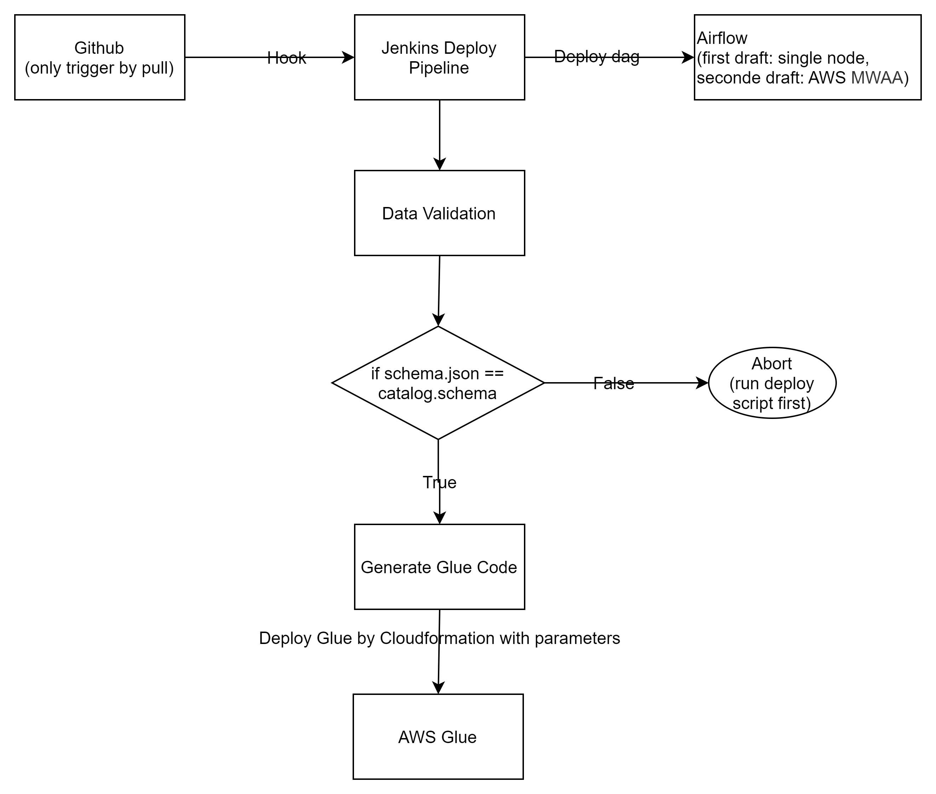
Architecture-basic logicflow

Slide 11

Project Milestone
Notes:
And as we drive into 2020, I want to emphasize both my expectations from you – and the support that you can expect to receive as we succeed together

Slide 12





Project Milestone
Milestone1(Q1)
What we done : Environment Ready
Value : Everyone was familiar with project technology, everyone familiar with developer tools.
Milestone2(Q2)
What we done :
Glue Framework
Airflow Framework
Add Requirements
Value: Familiar with cloud development and scrum, using Agile to quickly Build a Framework.
Milestone3(Q3)
What will do: Add Databricks
Value:
Milestone4(Q4)
What will do : Java/Reporting/HTML5

Slide 13

Project Status
Notes:
And as we drive into 2020, I want to emphasize both my expectations from you – and the support that you can expect to receive as we succeed together

Slide 14
CEDC Project Status
Done
In-progress
Incomplete
Milestone | Key Tasks / Next Steps | Purpose | Start | End | Status
Q1 | Kickoff | 了解项目背景 | March 17th | March 17th
Q1 | Sprint 1 | 环境配置 | March 20th | March 31st
Q2 | Sprint 2 | Glue - 框架-Onboarding | April 3nd | April 14th
Q2 | Sprint 3 | Airflow-框架-Onboarding | April 17th | Date 28th
Q2 | Sprint 4 | 完整Airflow框架功能点，添置需求
Q2 | Sprint 5 | 框架需求测试成功-完成上线

Slide 15

Project Details
Notes:
And as we drive into 2020, I want to emphasize both my expectations from you – and the support that you can expect to receive as we succeed together

Slide 16







Sprint 1 Environment Prerequisite
软件安装
账号申请
开发脚本 : 搭建Jenkins和Airflow
搭建环境

Slide 17
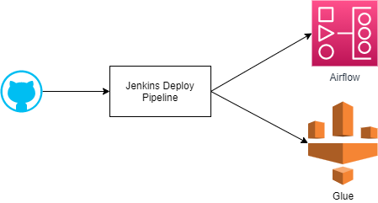
Sprint 2 -Jenkins DevOps Pipeline
Deploy airflow dags and glue job in project
Datasource Onboarding/Off Boarding:
Data validation
Convert SQL to Glue script
Insert source or footnote here

Slide 18
Sprint 2 Task Summary
Insert source or footnote here

Slide 19
Sprint 2 Task Details
Team | Total Task | Task Detail | Task Name | Estimate(Hours) | Total (Hours)
Team1 (Liuzhu, Luzhenzhen, HanKunyuan) | 2 | Task1 | Glue - Onboarding - IAM Role | 8 | 9
 |  | Task2 | SSM - Onboarding - 创建Jenkins密码 | 1
Team2 (JulieWang, LiHonghong, Carrie.Jing | 3 | Task1 | Glue - Script - Datasource - RDS -PostgreSQL | 8 | 11
 |  | Task2 | Glue - Onboarding - Create S3 Location | 1
 |  | Task3 | Glue - Onboarding - Database | 2
Team3 (ElaineZhang, LiuYuwei, SuXianfeng) | 4 | Task1 | Glue - Onboarding - Crawler - RDS - PostgreSQL | 5 | 16
 |  | Task2 | Glue - Onboarding - Connection - Connection Type = JDBC & SQL Server. | 4
 |  | Task3 | Glue - Script - Datasource - Sql Server | 2
 |  | Task4 | Glue - Onboarding - Crawler - JDBC - SQL Server. | 5
Team4 (LuYan, DingFangkui, Wu,David) | 3 | Task1 | Glue - Script - Convert Sql to Pyspark | 32 | 64
 |  | Task2 | Glue - Onboarding - Connection - Connection Type = NETWORK & S3 | 16
 |  | Task3 | Glue - Onboarding - Crawler - S3 | 16
Team5 (Lv Dian, HaoJing, MaCui) | 1 | Task1 | Glue - Script - Target - S3 | 8 | 8
Team6 (LiangJian, LiYanyan, Sun Money) | 1 | Task1 | jenkins - Onboarding - Glue related | 40 | 40
Team7 (RenLing, Elephant Jiang Sun Money) | 2 | Task1 | Glue - Script - Transform | 8 | 12
 |  | Task2 | Glue - Onboarding - Job. | 4

Slide 20
Sprint 2 燃起图
Insert source or footnote here

Slide 21
Sprint 3 Airflow Process Display
Main
start
Dependency Check
Monitor
E-mail
Skip
Run Glue
Trigger Next Dag
Stop
Insert source or footnote here

Slide 22
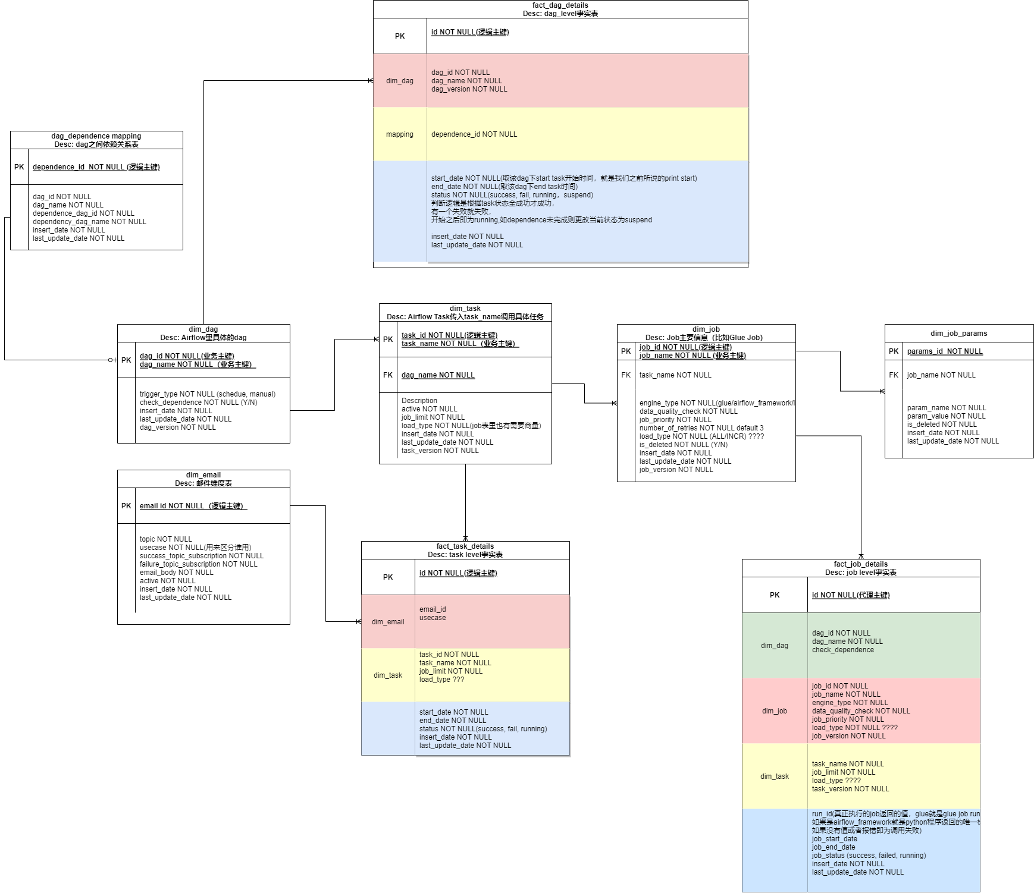
Sprint 3 Airflow Process Display
Insert source or footnote here

Slide 23
Sprint 3 Task Details
Owner | Total Task | Task Detail | Task Name | Estimate(Hours) | Total (Hours)
Julie& Carrie | 1 | Task1 | Main 调度 | 32
 | 1 | Task2 | Print Start time
Eiaine & Yuwei | 1 | Task3 | Dependency Check | 32
 | 1 | Task4 | Skip | 32
Lu Yan & RenLing | 1 | Task5 | Rule Glue Job | 32
Fangkui & Liu zhu | 1 | Task6 | Monitor Job | 32
LiangJian &Liyanyan | 1 | Task7 | Retry Job (Failed) | 32
David | 1 | Task8 | Send Email (Success) | 32
Hao Jing &MaCui | 1 | Task9 | Triger Next Dag | 32
 | 1 | Task10 | Stop

Slide 24

Project Value
Notes:
And as we drive into 2020, I want to emphasize both my expectations from you – and the support that you can expect to receive as we succeed together

Slide 25
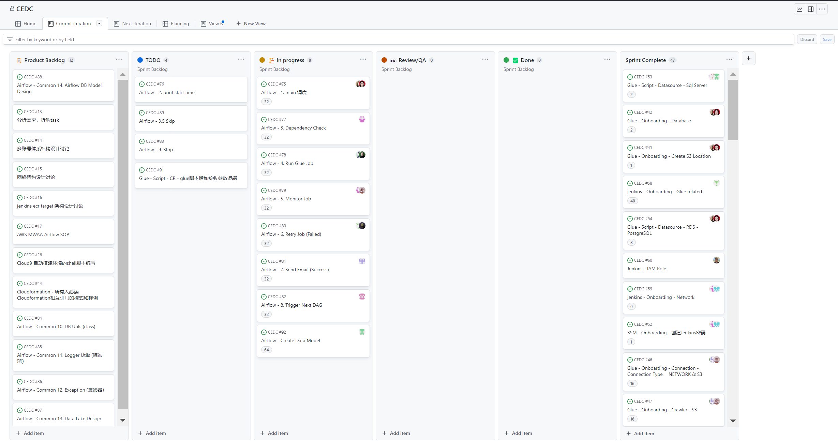
Manage Scrum Process

Slide 26
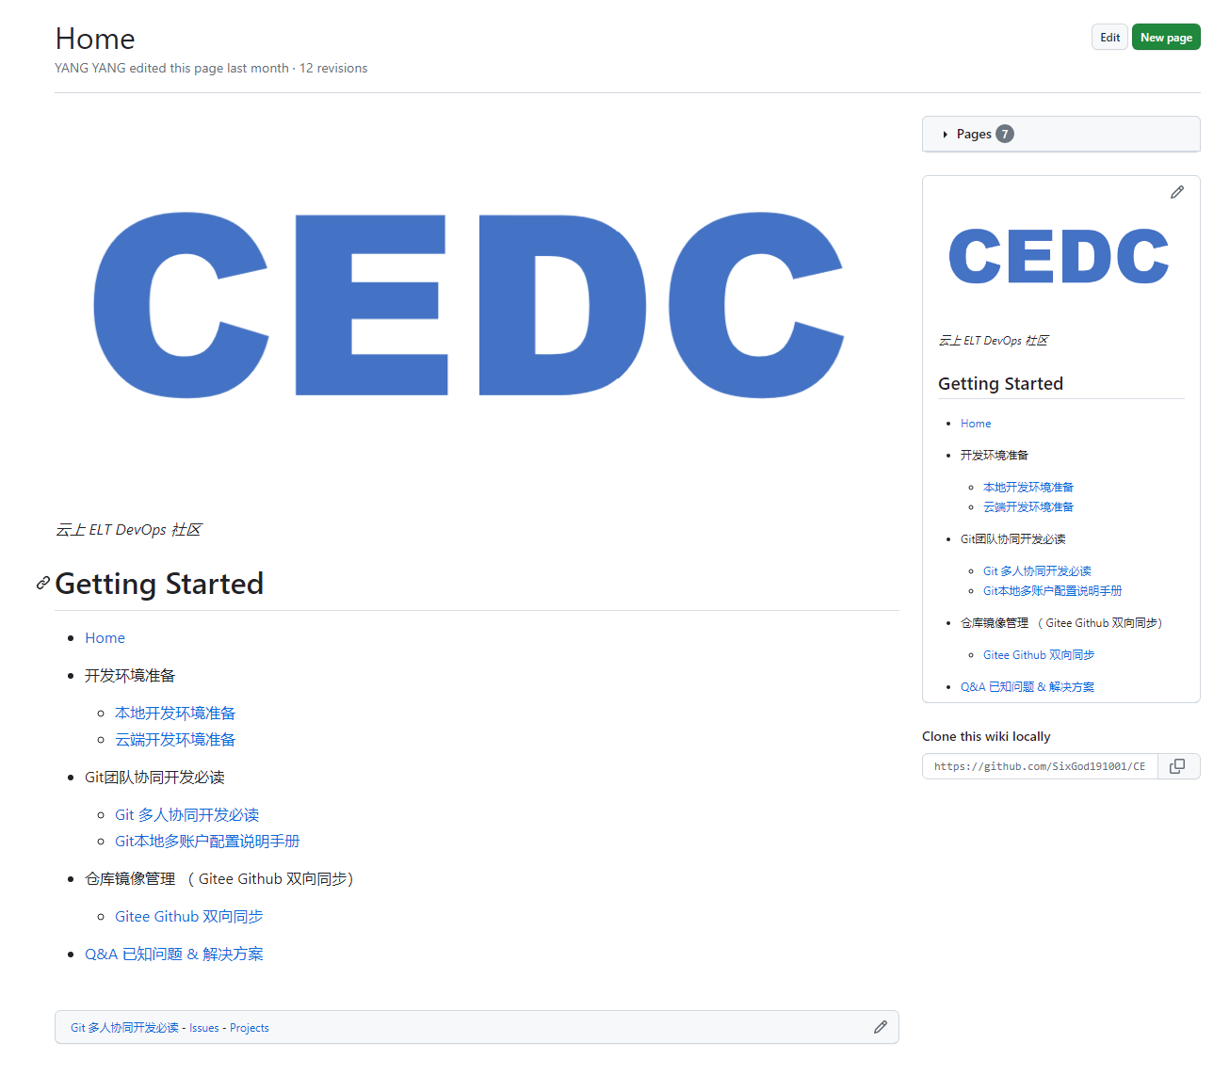
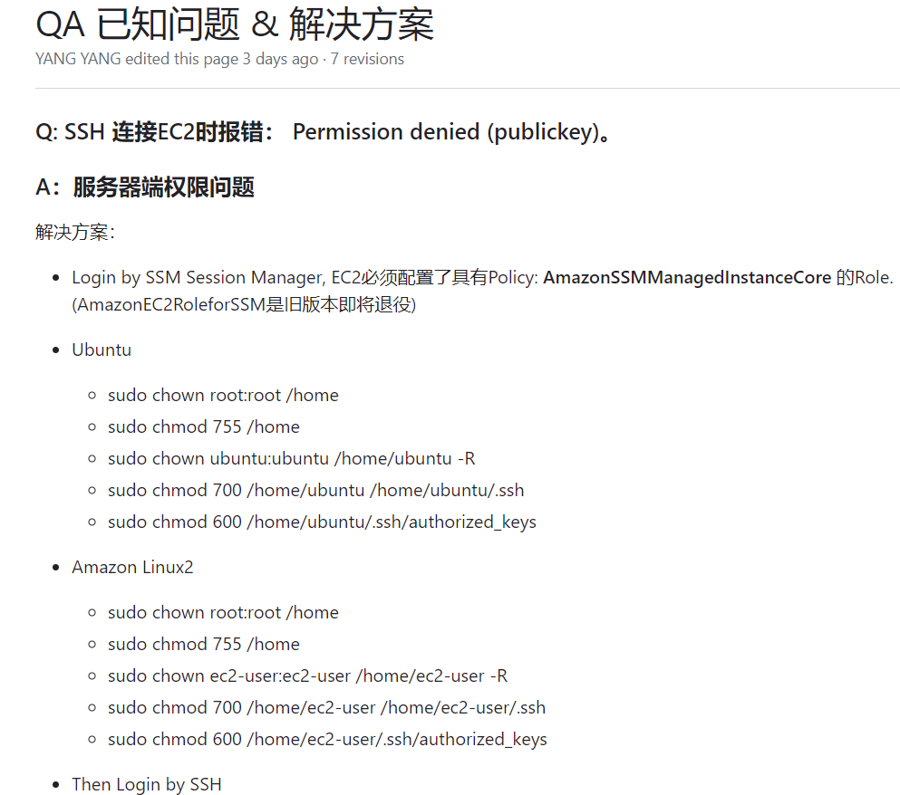
Manage WIKI
建立CEDC项目WIKI，供成员参考，快速了解项目前期准备以及开发工具的使用。
共同维护并记录Q&A文档，提高工作效率，快速解决问题

Slide 27

Personal Growth

Slide 28
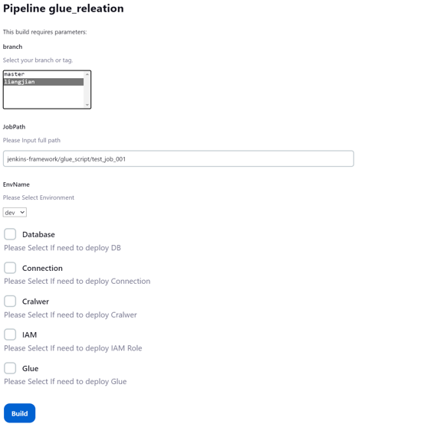
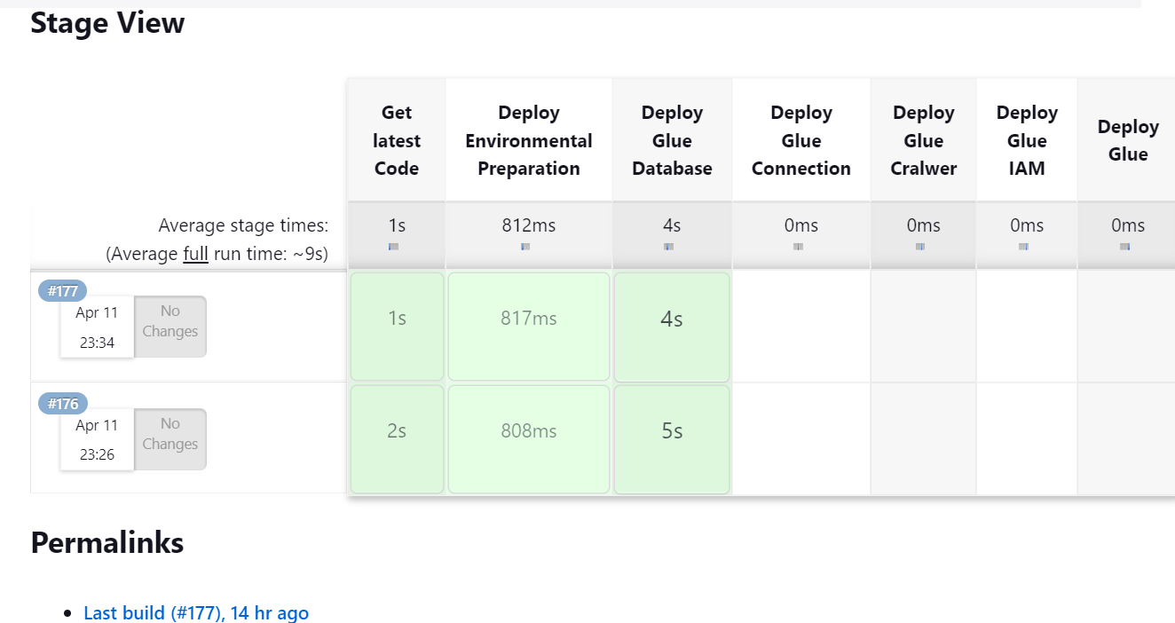
Glue Deployment Pipeline
Jenkins发布Glue(任何AWS Service),基础设施上线
实现自动化
检测Jenkins发布状态，是否上线成功
Notes:
Cognizant’s Vice Chairman & CEO Frank D’Souza and the executive leadership team are highly committed to creating an inclusive workforce, one that allows us to curate diverse pursuit and delivery teams which will ultimately create the diverse products and services our clients are seeking.
Here are a few dimensions of our companywide effort to advance D&I:
In 2018, Cognizant launched the Global D & I Council, which complements the work of our regional and local Diversity Councils.
The Cognizant Bronx Training helps New Yorkers access career opportunities in IT, digital and tech sectors. The program trained 650 individuals recruited from the five boroughs of New York at no cost to the students.
Partnership with FourBlock, which equips veterans with the professional
development and network needed to make strong career choices.
Cognizant Outreach is our employee-led global volunteer organization.
WE raises the profile of Cognizant’s women leaders by having them interact directly with hundreds of our clients and partners across the globe.
In May 2018, we launched the Cognizant U.S. Foundation, a nonprofit organization formed with an initial $100 million in funding to focus on supporting STEM and other technical education programs, keeping a sharp focus on diverse talent.
In 2018, Cognizant announced a new MAKERS sponsorship and publically pledged to help close the gender gap in technology.
The Cognizant U.S. Foundation made a $4.1 million grant to the National Center for Women & Information Technology. The grant will fund digital skills education programs and an awareness campaign designed to increase interest among women of all ages in pursuing technology careers.

Slide 29
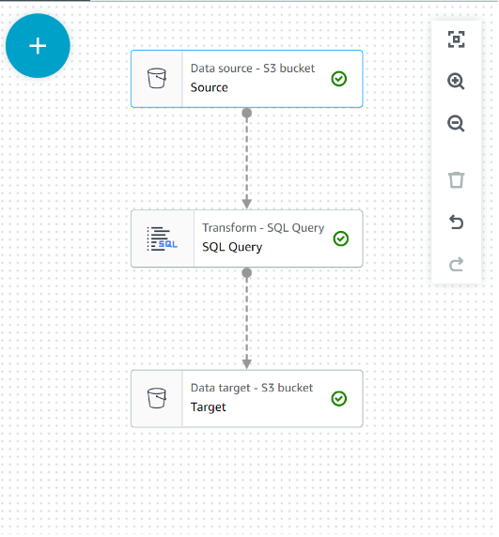
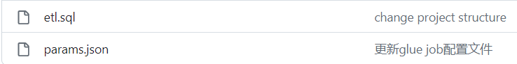
Transform
开发Glue Framework 解析sql文件，自动生成pyspark脚本
减少开发人员技术要求，只需将SQL 及参数放入相应模板
减少代码开发量，通过调用Jenkins Pipeline即可实现
可读性强，便于交接 OR 运维
Notes:
Cognizant’s Vice Chairman & CEO Frank D’Souza and the executive leadership team are highly committed to creating an inclusive workforce, one that allows us to curate diverse pursuit and delivery teams which will ultimately create the diverse products and services our clients are seeking.
Here are a few dimensions of our companywide effort to advance D&I:
In 2018, Cognizant launched the Global D & I Council, which complements the work of our regional and local Diversity Councils.
The Cognizant Bronx Training helps New Yorkers access career opportunities in IT, digital and tech sectors. The program trained 650 individuals recruited from the five boroughs of New York at no cost to the students.
Partnership with FourBlock, which equips veterans with the professional
development and network needed to make strong career choices.
Cognizant Outreach is our employee-led global volunteer organization.
WE raises the profile of Cognizant’s women leaders by having them interact directly with hundreds of our clients and partners across the globe.
In May 2018, we launched the Cognizant U.S. Foundation, a nonprofit organization formed with an initial $100 million in funding to focus on supporting STEM and other technical education programs, keeping a sharp focus on diverse talent.
In 2018, Cognizant announced a new MAKERS sponsorship and publically pledged to help close the gender gap in technology.
The Cognizant U.S. Foundation made a $4.1 million grant to the National Center for Women & Information Technology. The grant will fund digital skills education programs and an awareness campaign designed to increase interest among women of all ages in pursuing technology careers.

Slide 30

Project Challenge
Notes:
And as we drive into 2020, I want to emphasize both my expectations from you – and the support that you can expect to receive as we succeed together

Slide 31
Challenge
Problem Description | Status | Solution | Comment | Stage
如何平衡本身项目和CEDC时间 | 待解决 | 暂无 | 待定方案: 利用个人时间进行学习 | Sprint2～3
任务所涉及的时间分配问题，进度无法控制 | 待解决 | 暂无 | 待定方案: 如果由于项目原因时间无法分配，组内成员互相Backup, 密切交流，了解Task的具体细节 | Sprint2～3
只了解自己当前Task ,不了解整体流程 | 已解决 | 增加Task演示会环节，帮助大家了解串起整个流程 |  | Sprint2～3
开发人员技术水平不一致 | 已解决 | 1.安排同事讲解Python代码基础框架，语法，逻辑。帮助成员建立Python逻辑思维 2. 学习项目Python案例，先当代码的“搬运工” |  | Sprint2～3
开发交付标准想法多元化 | 已解决 | 线下及时沟通 |  | Sprint2～3

Slide 32

Project Member
Notes:
And as we drive into 2020, I want to emphasize both my expectations from you – and the support that you can expect to receive as we succeed together

Slide 33




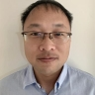


















Team Introduction
Scrum Team
Julie Wang
SM
Yang Yang
PO
Jiang Ran
Dev-Arch
Li Honghong
Dev-Arch
Liang Jian
Dev - Arch
Lu Yan
Dev
Lv Dian
Dev-Arch
Liu Zhu
Dev
Elaine
Dev
Ren Ling
Dev
Carrie Jing
Dev
Sun Qian
Dev
Wu David
Dev
Hao Jing
Dev
Lu Zhenzhen
Dev
Su Xianfeng
Dev
Binbin.cheng
Dev
Wang Jinjing
Dev
Li Yanyan
Dev
Ding Fangkui
Dev
Ma Cui
Dev
Han Kunyuan
Dev
Liu Yuwei
Dev
Notes:
Presenter:TD

Slide 34

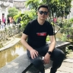

Team Introduction
BO Team
Wendy Wang
BO-Novartis
Jiang Ran
BO-Merck
Liang Jian
BO-Merck
Lv Dian
BO-Merck
Hao Jing
BO-Novartis
David Cui
BO
SM Team
Julie Wang
SM
Shirley
Deputy-SM
Carrie
Deputy-SM
Notes:
Presenter:TD

